Slide 1
SYSTOR’22
Dedup-for-Speed: Storing Duplications in Fast Programming Mode for Enhanced Read Performance
Jaeyong Bae, Jaehyung Park, Yuhun Jun, Euiseong Seo
CHANGWON NATIONAL UNIVERSITY

Slide 2
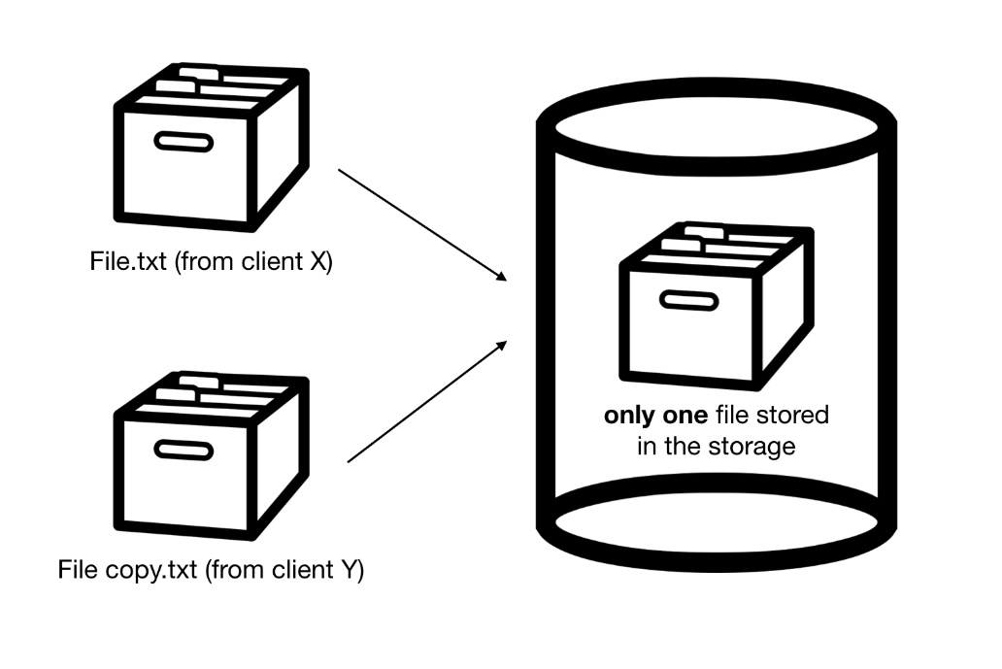
Introduction
Storage deduplication
Increase the amount of available space
Improve write latency by eliminating redundant write
Deduplication in SSD
Extend lifespan of flash cells(fewer writes → less wear)
Deduplication concept
https://jinwooooo.github.io/jinwooooo-blog/simple-deduplication-theory/

Slide 3
Introduction
SSD use a flash translation layer(FTL) to emulate the block device interface
Due to its characteristics of erase-before-write(cannot overwrite)
Erase: block unit
Write: page unit
FTL mapped logical page number(exposed to host) to physical page number
…
Kernel
File System
Block Device Driver
SSD
Flash Translation Layer
Flash controller
Block
Flash memory

Slide 4

Introduction
SSD can easily realize deduplication
By enabling FTL to map logical pages with data to single physical page
But its benefits are not directly appealing to the users
Most existing file system cannot directly use the additional capacity obtained form deduplication
Metadata of a file system must be predetermined capacity
User cannot recognize the reduced write operation
SSD write buffer(DRAM) absorb the performance gain
Not directly translated into a reduced execution time of the host workloads.
File system
LPN
?
FTL
Capacity obtained form deduplication
PPN

Slide 5
Introduction
Deduplication occurs read performance degradation
If the storage device performs deduplication in units of pages,
It breaks the sequentiality of physical page access when duplicated pages in the middle of file
In most circumstances, read requests are more frequent than write
Furthermore, duplicated pages are more likely to be accessed than normal pages

Slide 6
Introduction
This study proposes a Dedup-for-speed(DFS) method
FTL supports deduplications
The primary goal of DFS is to improve the read performance
DFS invest the additional capacity obtained through deduplication to use fast flash mode

Slide 7
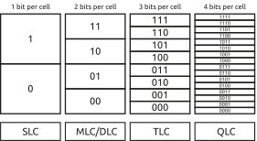
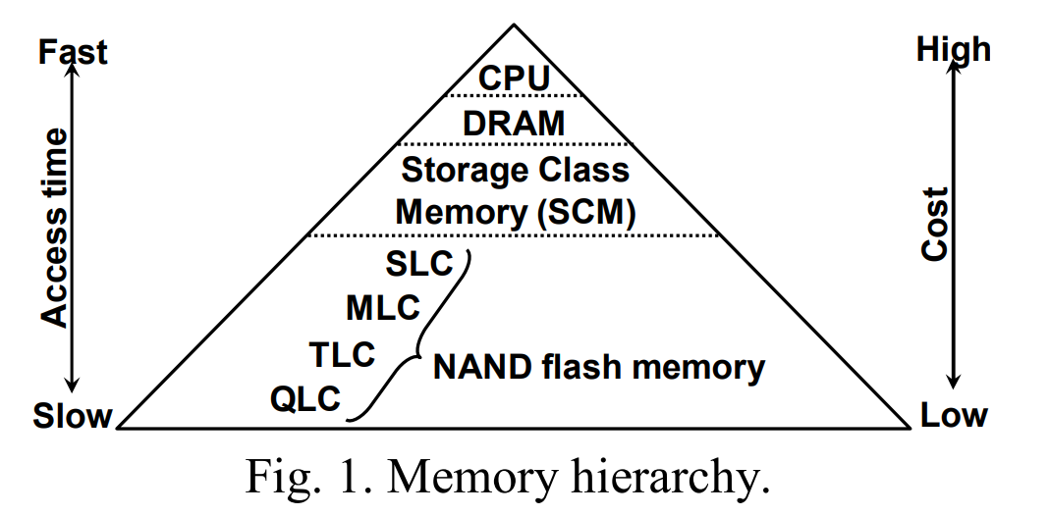
Introduction
Flash mode
Recently, commercial SSD use multi-level cell (MLC), triple-level cell(TLC), and QLC flash chips
High density of flash memory chips results in slower read(voltage granularity) and write
The structure of high-density flash chips is fundamentally the same as low-density
So, high-density flash chips can be programmed in the lower density mode
Takai Y. et al., Analysis on Heterogeneous SSD Configuration with Quadruple-Level Cell (QLC) NAND Flash Memory, IEEE IMW, 2019

Slide 8
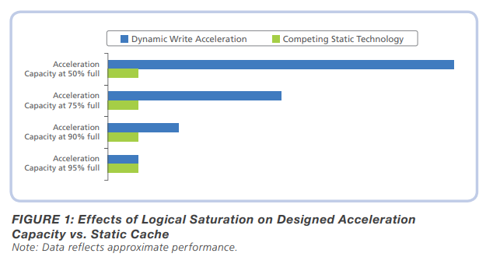
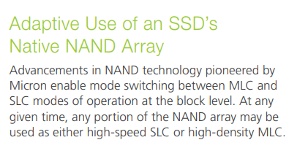
Introduction
Flash mode(Cont.)
Most commercial SSD controllers can switch the flash mode
A few SSDs use a portion of their MLC flash as a fast write buffer by programming them in pseudo-SLC(pSLC)mode
DFS stores duplicated pages in lower-density flash modes
Called ‘fast flash mode’
More duplicated pages move to more lower-density
Block level dynamic flash mode switching
Micron technical marketing brief,
https://www.micron.com/-/media/client/global/documents/products/technical-marketing-brief/brief_ssd_dynamic_write_accel.pdf

Slide 9
Introduction
DFS stores duplicated pages in lower-density flash modes(cont.)
Ex.) DFS stores twice duplicated pages in pMLC pages and four times duplicated pages in pSLC pages in a QLC SSD
Cause there are more likely to access it frequently than doubly duplicate one.
Frequent access → DFS guarantee fast access!

Slide 10
Background and related work
SSD have an additional capacity to 7-28% of the nameplate capacity
Over-provisioning space(OPS)
Deduplication inside an SSD has the effect of increasing the OPS
Deduplicated page is used as on OPS that the host(file system) cannot aware of

Slide 11
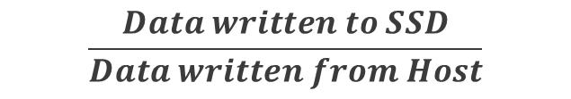
Background and related work
SSD have an additional capacity to 7-28% of the nameplate capacity(cont.)
With a larger OPS, the SSD can maintain a longer GC interval
Also reduce the number of copied valid pages
Consequently, write amplification factor(WAF) is reduced
Deduplication inside SSD lowers GC overhead, Increase performance and flash lifespan
호스트가 요청한 크기의 데이터 write를 수행하기 위해
실제 SSD에서의 데이터 write 크기비율(1에 가까울 수록 이상적임)
$$\frac{Data written to SSD}{Data written from Host}$$
SSD use OPS to write pages if there are not enough free pages

Slide 12
Background and related work
Inline deduplication
Perform deduplication during a write operation
Skip writing to flash memory(pre-removal duplication page)
Reducing write latency and WAF

Slide 13
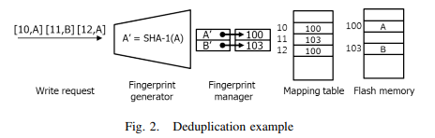
Background and related work
Comparing pages on byte-to-byte to check for deduplication is inefficient
Additional read operation is required
Most deduplication schemes obtain a hash value of a page with a hash function
SHA-1 or CRC
Kim J. et al., Deduplication in SSDs: Model and quantitative analysis, IEEE MSST, 2012

Slide 14
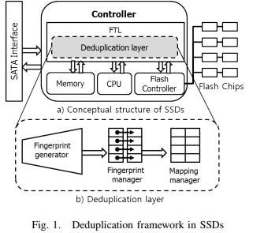
Background and related work
Each Page’s hash value called fingerprint(FP)
Using FP that is significantly smaller than a page
Reduce the overhead of finding identical pages
Although FP occupy smaller space, it is practically impossible to store all of FP
Require a large amount of DRAM space
FP searching overhead during inline deduplication
Kim J. et al., Deduplication in SSDs: Model and quantitative analysis, IEEE MSST, 2012

Slide 15
Background and related work
CAFTL solve this problem performing both inline and out-of-line deduplications
Out-of-line (a.k.a post-processing or out-of-bound)
CAFTL performs content-based sampling on write requests to generate FP of pages
Content-based sampling filter the higher probability of redundant data
When SSD is idle, CAFTL initiate out-of-line deduplication without generate FP

Slide 16
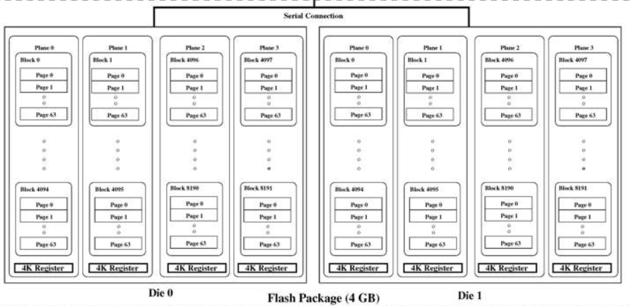
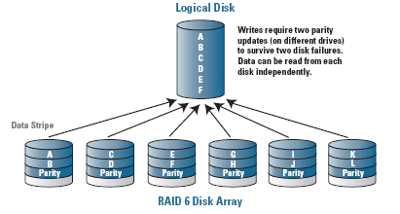
Background and related work
Modern SSD support internal parallelism
Parallel access to SSD’s internal dies and channel
단일 전송 대역폭이 최대 30~40MB 인 물리적 한계가 존재
이를 극복하기 위해 내부적으로 여러 개의 플래시 칩에 동시에 접근 할 수 있는 기능을 제공
FTL에 의해 순차적인 데이터를 물리적으로 연속되지 않더라도 다른 칩에 저장 가능
내부적으로 data striping 가능
순차쓰기 수행 시 내부 병렬화가 극대화 → 높은 성능, 데이터 순차성을 유지하는 것이 성능에 영향을 미침
Data striping in RAID, https://www.anandtech.com/show/2319/3
Agrawal N. et al., Design Tradeoffs for SSD Performance USENIX legacy content, https://www.usenix.org/legacy/events/usenix08/tech/full_papers/agrawal/agrawal_html/index.html

Slide 17
Design overview
DFS(Deduplication-for-Speed) is a deduplication FTL
Improves both the read and write performance
DFS prevents redundant data store to increase write throughput
Same as existing deduplication FTLs
In addition, DFS utilizes the free space obtain through deduplication
Store duplication data in fast flash mode(pSLC or pMLC) to improve read performance

Slide 18
Design overview
However, a page written in fast-flash modes consumes two or for times capacity
Amount of data stored in the fast flash modes increase → Capacity efficiency is decrease
To solve this problem, DFS match the duplication count and flash mode
Ex) twice duplicated pages are stored in pMLC mode in a QLC SSD
Capacity will remain the same!
QLC(Store 4bit)
pMLC(Store 2bit)
QLC(Store 4bit)
Duplication page
Deduplication
(remain unique)
Duplication page
Duplicated count:2

Slide 19
Design overview
DFS performs inline deduplication
Host send write request → check duplication → execute write operation
By reducing duplicate writes, DFS also has the benefits of improved write performance
DFS has additional deduplication and promotion module

Slide 20
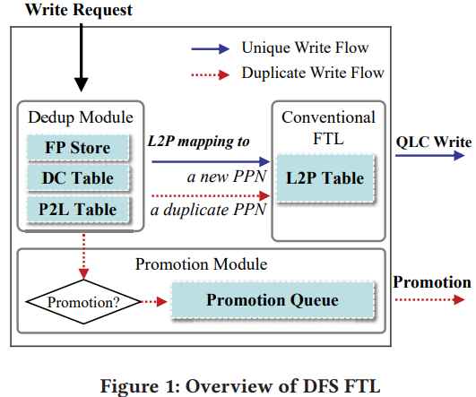
Design overview
The promotion module is responsible for the promotion operation
Promotion: Migrates the duplicated pages to the proper fast flash mode pages

Slide 21
Design overview
DFS uses a post-processing promotion mechanism
Prevent host reads and writes from being interrupted by promotion operations
Minimizing the adverse performance impact

Slide 22
Design overview
Write request to a fast flash mode page is issued
DFS first write the incoming page to a QLC page
DFS performs demotion of the fast flash mode page
Depending on the changed duplication count in turn
Demoted page moves to an appropriate flash mode page
Promotion: move to fast flash mode
Demotion: move to slow(or normal) flash mode
Demotion mechanism proceed with GC, reclaim storage capacity

Slide 23
Design overview
Dedup module operation is similar to conventional inline deduplication
Dedup module comprise three main data structure
Fingerprint(FP) store: stores the hash values of pages
P2L mapping table: stores address of logical pages pointing to the physical page
Duplication count(DC) table: stores the number of deduplicated logical pages on each physical page

Slide 24
Design overview
If calculated hash value of write requested page is in FP store, which is determined duplicated
P2L mapping table is also used to identify the related entries in L2P table
P2L mapping table used to determine promotion
DC table is used to quickly determine the target flash mode for promotion/demotion

Slide 25
Design overview
DFS inline deduplication
FP store
SHA-1
Hash value
Physical page
Write empty page in QLC block
FP matched?
Write requested
page arrived
Fingerprint
Generator
No
Yes
logical page
Physical page
Update P2L table &
Increase DC count of corresponding physical page
Omit write operation
&
find physical page from FP store
Update L2P mapping & FP store
L2P mapping with target logical page

Slide 26
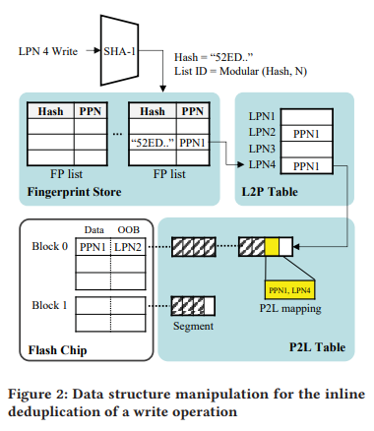
Design overview
FP store should be located in DRAM
Dedup module can quickly search FP during write request processing
Each FP holds a pair of fingerprint : PPN
Increasing FP entries → Increasing search time
FP store is divided into N lists
The entry of the page with fingerprint f enters the f%N-th list(Modular)
DFS set N to 256
“52ED”
mod
LPN
FP generator
52ED % 4
0 ~ 3
4 lists

Slide 27
Design overview
If number of FP entries exceed the maximum number
The oldest entry is deleted
LRU manner

Slide 28
Design overview
After updating the L2P mapping
FTL notifies the host of the completion of the write request
Start adding a new P2L mapping entry to the P2L table
P2L mapping is a PPN : LPN pair
Such a pair is created each time deduplication occur(as described previous slide)
P2L table used at promotion operation

Slide 29
Design overview
P2L table require large memory space
P2L table store all mapping information on the deduplicated page
Some deduplication FTLs use an area of NVRAM in SSD to store P2L table
DFS also store the P2L table to NVRAM
P2L entries is allocated to NVRAM in unit of segments
Segment has size of 1KB
128 P2L entries are stored in a segment
Sequentially stored in log-structured manner
DC table stores same way

Slide 30
Design overview
In the last step of write operation in DFS,
DFS insert PPN into the promotion queue that has sufficiently high deduplication count to use a higher flash mode
Promotion operation performed when the SSD is in an idle state
Promotion module to avoid interfering host request
Promotion module dequeue the oldest PPN from promotion queue
Promotion queue following the FIFO

Slide 31
Design overview
Promotion module recheck current DC
If the current DC on the page in the promotion queue has decreased → go to next
If the current DC on the page in the promotion queue has increased very frequently in time
→ two-step promotion

Slide 32
Design overview
DFS maintains an open block for each supported flash mode(pSLC, pMLC, QLC)
A page to be written in a specific flash mode is allocated corresponding open block
SLC free page → allocated in SLC open block
If no more free pages in the SLC open block
One of free blocks is allocated as the SLC open block

Slide 33
Design overview
Assume that the some PPN’s flash mode is determined
Original PPN is copied to free page of the corresponding flash mode
페이지 복사 후, 원본 PPN이 속한 P2L 세그먼트를 탐색하여 LPN 매핑정보를 찾는다.
LPN 정보를 가지고 FTL 내 L2P 테이블에서 승격된 페이지의 PPN 정보를 업데이트한다.
이후 P2L 매핑도 업데이트한 후, 원본 페이지는 invalid 된다.
When the promotion of page is complete,
Promotion module check SSD state
If still idle, go on next page’s promotion operation

Slide 34
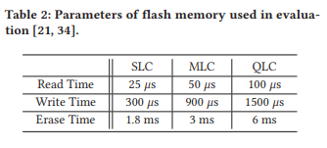
Evaluation
DFS implemented in SSDsim
SSDsim is modified to convert free flash block into different programming modes
To this, SSDsim need to use multiple timing parameters according to the programming mode of the page to be written or read

Slide 35
Evaluation
DFS inline deduplication is similar to Remap-SSD
So, assume that the computational overhead of inline deduplication is the same as Remap-SSD
DFS fingerprint search is optimized from the original Remap-SSD design
This assumption is unfavorable for DFS
Comparison target
Original SSDsim: No-Dedup
Remap-SSD(using the optimized fingerprint search mechanism of DFS): Dedup
DFS

Slide 36
Evaluation
Effects of deduplication storage devices,
I/O trace must include at least hash valuse
But, published I/O trace include only access sequence of block number
For that, this paper used hypothetical synthetic workloads.
FIU I/O trace contain the hashes of accessed block
http://iotta.snia.org/traces/block-io/390

Slide 37
Evaluation
Analysis with hypothetical workloads
데이터 사용빈도 분포에 따른 DFS 분석
합성 워크로드를 Zipf parameter를 조정하여 데이터 사용빈도를 조절
Zipf law: 자연상태의 정보집합에서 정보의 사용빈도는 사용빈도 순위에 반비례하는 특성을 가짐
예) 말뭉치에서 1번째로 사용빈도가 높은 단어는 2번째로 사용빈도가 높은 단어보다 빈도가 두배 높음
빈도순위 3위 → 1위 빈도수의 1/3 의 빈도수를 가짐 : 빈도순위=3, 빈도수=1위의 1/3

Slide 38
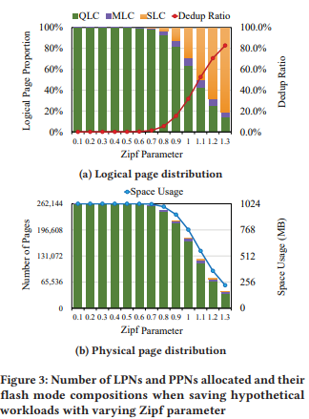
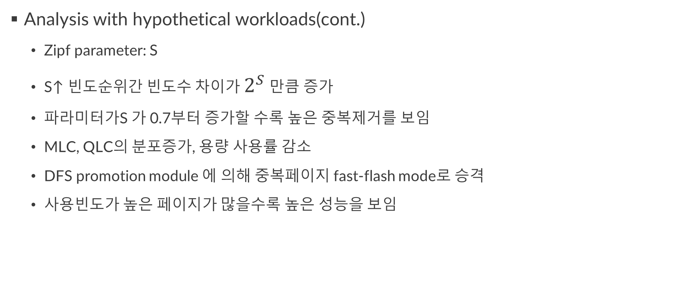
Evaluation
Analysis with hypothetical workloads(cont.)
Zipf parameter: S
S↑ 빈도순위간 빈도수 차이가 $2^{S}$ 만큼 증가
파라미터가S 가 0.7부터 증가할 수록 높은 중복제거를 보임
MLC, QLC의 분포증가, 용량 사용률 감소
DFS promotion module 에 의해 중복페이지 fast-flash mode로 승격
사용빈도가 높은 페이지가 많을수록 높은 성능을 보임

Slide 39
Evaluation
Read latency evaluation due to deduplication
Set the workload to sequentially write 1GB
Write unit of pages is 32KB
Three Zipf parameter value : 15%, 32%, 70%
15%, 32%, 70% pages were deduplicated
Performed sequential read operations on 1GB data
64KB, 128KB, 1M

Slide 40
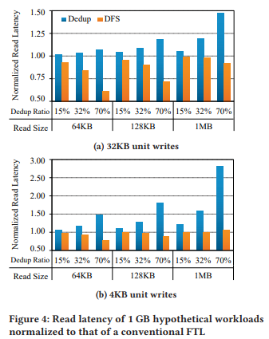
Evaluation
Read latency evaluation due to deduplication
Dedup showed poorer read latency than DFs in all case
Sequentiality of PPNs was broken at 32KB by deduplication
Larger read unit increase read latency
DFS showed a shorter read latency in all cases
Effect of fast-flash mode for deduplicated page

Slide 41
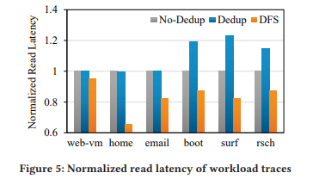
Evaluation
Analysis with Real-World workloads
web-vm: collected from two web service virtual machine
home: I/O trace of research group ‘s NFS filer server
email: I/O trace of email server
boot: I/O traces produced during system boot-up
surf: I/O trace collected several hour of web surfing
rsch: I/O trace collected from diverse research activities
(file downloads, writing word processor, compiling codes)
All trace extracted by using blktrace

Slide 42
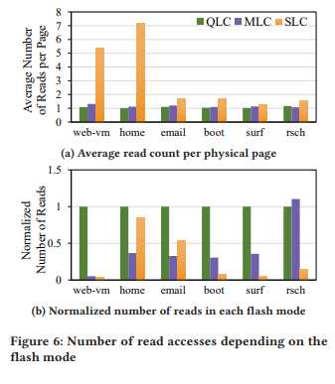
Evaluation
Analysis with Real-World workloads(cont.)
↑ duplicated page, ↑ read count
But, total number of read performed in each flash mode,
Did not find a common pattern

Slide 43
Conclusion
Deduplication SSD reduce write latency
Also save memory space(reduced WAF, GC overhead)
However, it may breaks sequentiality at the flash page level
Results in degradation of read performance
This study proposed novel dedup FTL scheme, DFS
Trade the additional space for improve read performance using fast flash mode
DFS with six real-world workload traces showed that it can improve the read latency by up to 34 % and 16 % on average.

